Slide 1
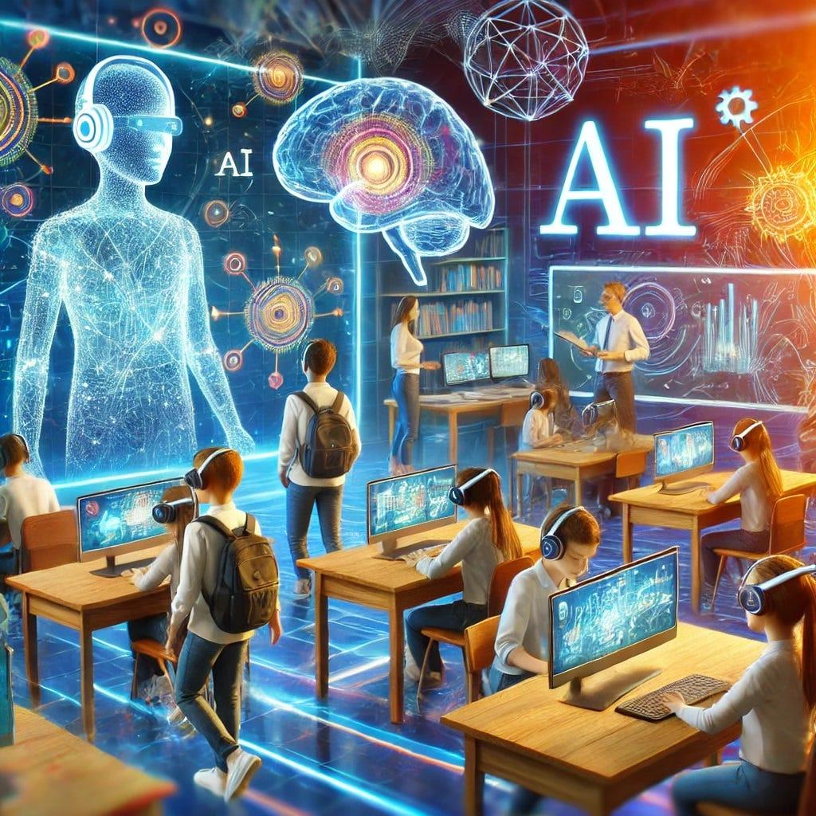
Introduction to the AI Course
This course aims to provide a robust understanding of Artificial Intelligence and its significance in today's technological landscape.
Objectives: Equip students with foundational knowledge and practical skills in AI.
Structure: The course will cover theoretical concepts, practical applications, and hands-on projects.
Importance: AI is transforming industries, making it essential for students to grasp its principles and applications. Let’s embark on this exciting journey into the world of AI!

Slide 2

Core Topics Explored
Key Topics Covered:
Machine Learning: Techniques that enable computers to learn from data.
Natural Language Processing: Understanding and generating human language.
Computer Vision: Enabling machines to interpret and understand visual information.
These core topics will provide students with a comprehensive foundation in AI.

Slide 3

Practical Applications of AI
AI has numerous real-world applications across various industries:
Healthcare: AI assists in diagnostics and personalized treatment plans.
Finance: Algorithms detect fraud and optimize trading strategies.
Transportation: Autonomous vehicles rely on AI for navigation and safety.
Students will learn how to leverage AI skills in their future careers, enhancing their employability.

Slide 4

Assessment and Evaluation
Grading Criteria:
Assignments: Practical projects and theoretical assessments will contribute to overall grades.
Exams: Mid-term and final exams will test comprehension of course material.
Participation: Active engagement in discussions and group work will be evaluated.
Understanding these expectations is crucial for achieving success in the course.

Slide 5

Conclusion and Future Opportunities
Key Takeaways:
Mastery of AI concepts and techniques.
Insight into practical applications and industry relevance.
Advanced Career Opportunities:
Graduates can pursue roles in data science, machine learning engineering, and AI research.
Continuous learning in AI can lead to leadership positions in tech-driven organizations.
The knowledge gained in this course will open doors to exciting career paths in AI.

Slide 6

Game Playing Algorithms
Minimax Algorithm:
Used in two-player, zero-sum games like chess and tic-tac-toe.
Aims to minimize the possible loss for a worst-case scenario.
Alpha-Beta Pruning:
Enhances Minimax by eliminating branches that won’t affect the final decision.
Improves efficiency in searching the game tree.
These algorithms are foundational in developing strategic AI applications.

Slide 7

Constraint Satisfaction Problems (CSP)
Components of CSP:
Variables: Represented as X, Y, Z.
Domains: Possible values, e.g., {Red, Green, Blue}.
Constraints: Conditions that must be met, e.g., X ≠ Y.
CSPs are crucial for solving problems in scheduling, resource allocation, and more.

Slide 8

Logic and Reasoning
Propositional Logic:
Focuses on statements that are either true or false.
Example: If it rains → The ground is wet (P → Q).
Understanding logic is essential for developing reasoning capabilities in AI systems.

Slide 9

Normal Forms
CNF (Conjunctive Normal Form)
Represents logical formulas as an AND of ORs.
DNF (Disjunctive Normal Form)
Represents logical formulas as an OR of ANDs. These forms are important for simplifying logical expressions in AI.

Slide 10

Predicate Logic
Key Features:
Utilizes variables and quantifiers: ∀x (for all x), ∃y (there exists y).
Example: ∀x (Student(x) → Studies(x)), indicating that all students study.
Predicate logic enhances the expressiveness of AI systems.

Slide 11

Optimization Algorithms
Branch and Bound
Explores all possible solutions while pruning paths that exceed known bounds.
Commonly used in problems like the Traveling Salesman Problem (TSP) and job scheduling. Optimization algorithms are vital for efficient problem-solving in AI.

Slide 12

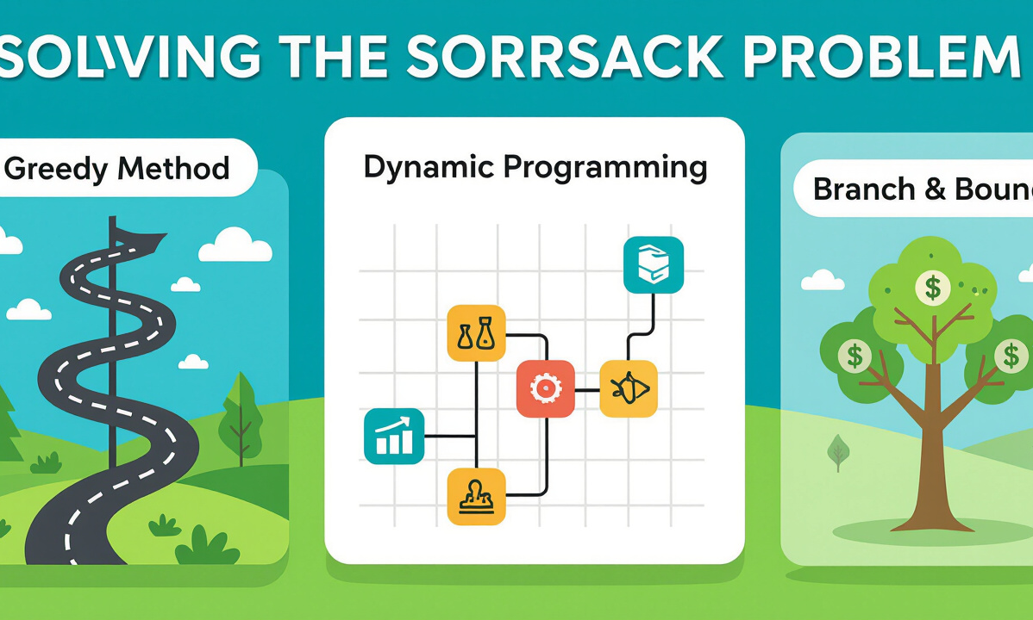
Knapsack Problem
Problem Definition
Solving Approaches
The Knapsack Problem involves selecting items to maximize value without exceeding a weight limit.
There are several approaches to solve the Knapsack Problem: ⚡ Greedy Method selects items based on value-to-weight ratio, 🧠 Dynamic Programming breaks the problem into simpler subproblems, and ⛓️ Branch & Bound explores feasible solutions while eliminating non-promising ones. Understanding these approaches equips students to tackle complex optimization challenges.

Slide 13
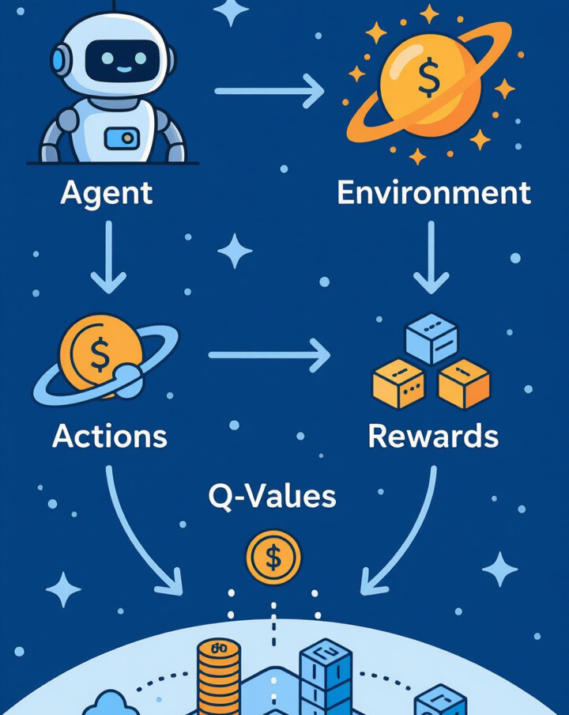
Reinforcement Learning (RL)
Core Elements
Agent: Learns to make decisions.
Environment: The context in which the agent operates.
Actions: Choices made by the agent.
Rewards: Feedback from the environment.
Policy & Q-Values: Strategies for decision-making based on learned experiences. Reinforcement learning is essential for developing intelligent agents capable of learning from interactions.

Slide 14
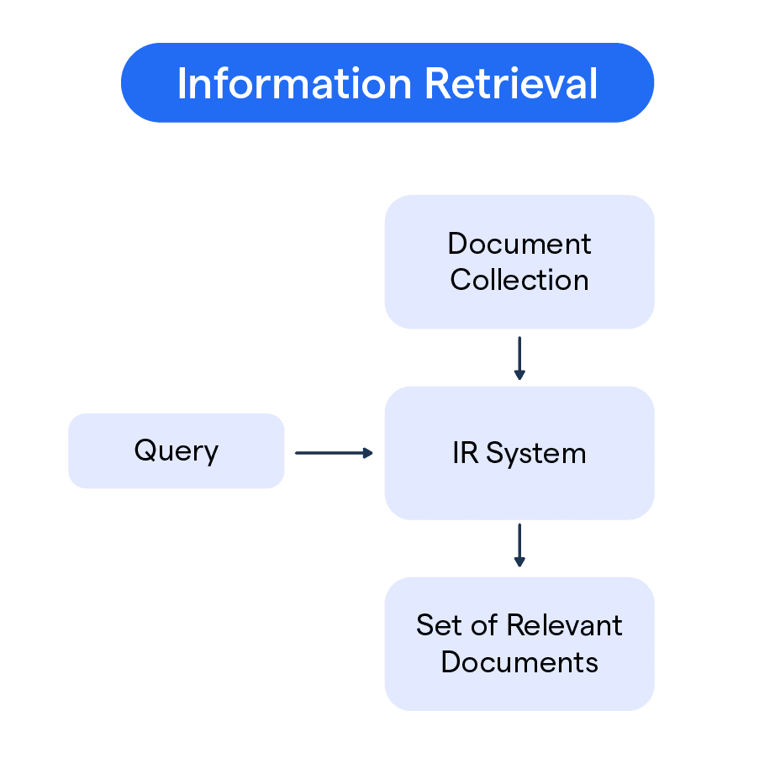
Information Retrieval (IR)
Process Involves:
Document Indexing: Organizing information for efficient retrieval.
Query Processing: Interpreting user queries to find relevant information.
Ranking Results: Prioritizing search results based on relevance.
IR is fundamental in developing search engines and data retrieval systems.

Slide 15
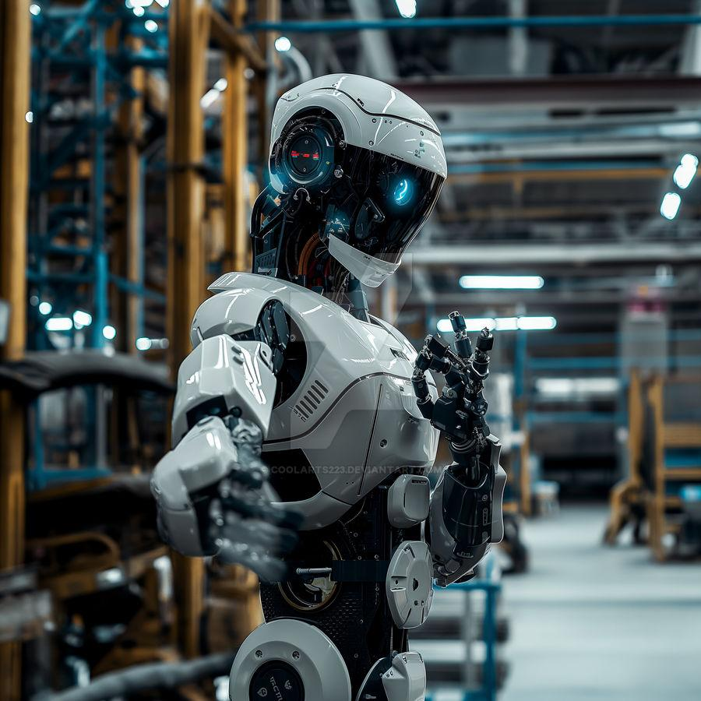
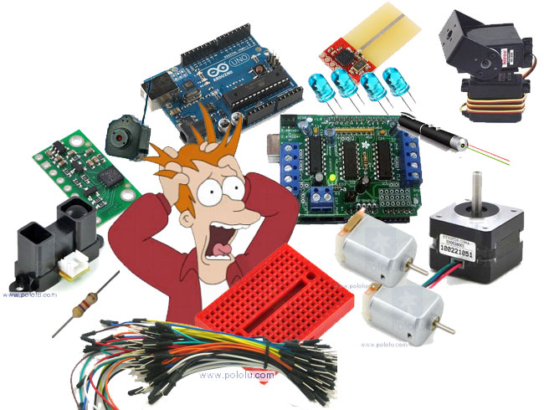
Robotics
Definition
Hardware Components
A robot is an intelligent machine capable of performing tasks autonomously or semi-autonomously.
Key hardware components include: Sensors that gather data from the environment, Actuators that enable movement and interaction, Motors that provide mechanical motion, and Microcontrollers that process information and control robot functions. Understanding these components is essential for designing and building robotic systems.

Slide 16

Software Components
Key Software:
ROS (Robot Operating System): Framework for developing robot software.
Pathfinding Algorithms: Enable robots to navigate environments.
AI Logic Modules: Implement decision-making capabilities.
These software components are crucial for effective robotic functionality.

Slide 17
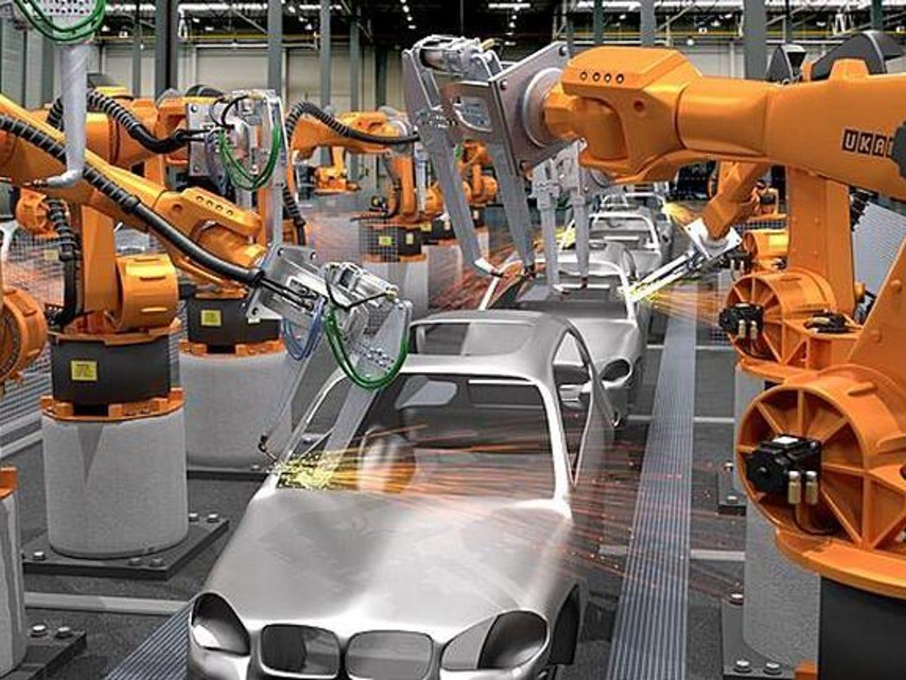
Applications of Robotics
Robotics has diverse applications, including:
🏭 Industrial Automation: Streamlining manufacturing processes.
🩺 Medical Surgery: Assisting in precise surgical procedures.
🪖 Military Operations: Enhancing operational efficiency and safety.
🏠 Domestic/Home Cleaning: Automating household chores.
🚀 Space Exploration: Enabling missions beyond Earth.
Robotics is transforming various sectors, showcasing its vast potential.

Slide 18
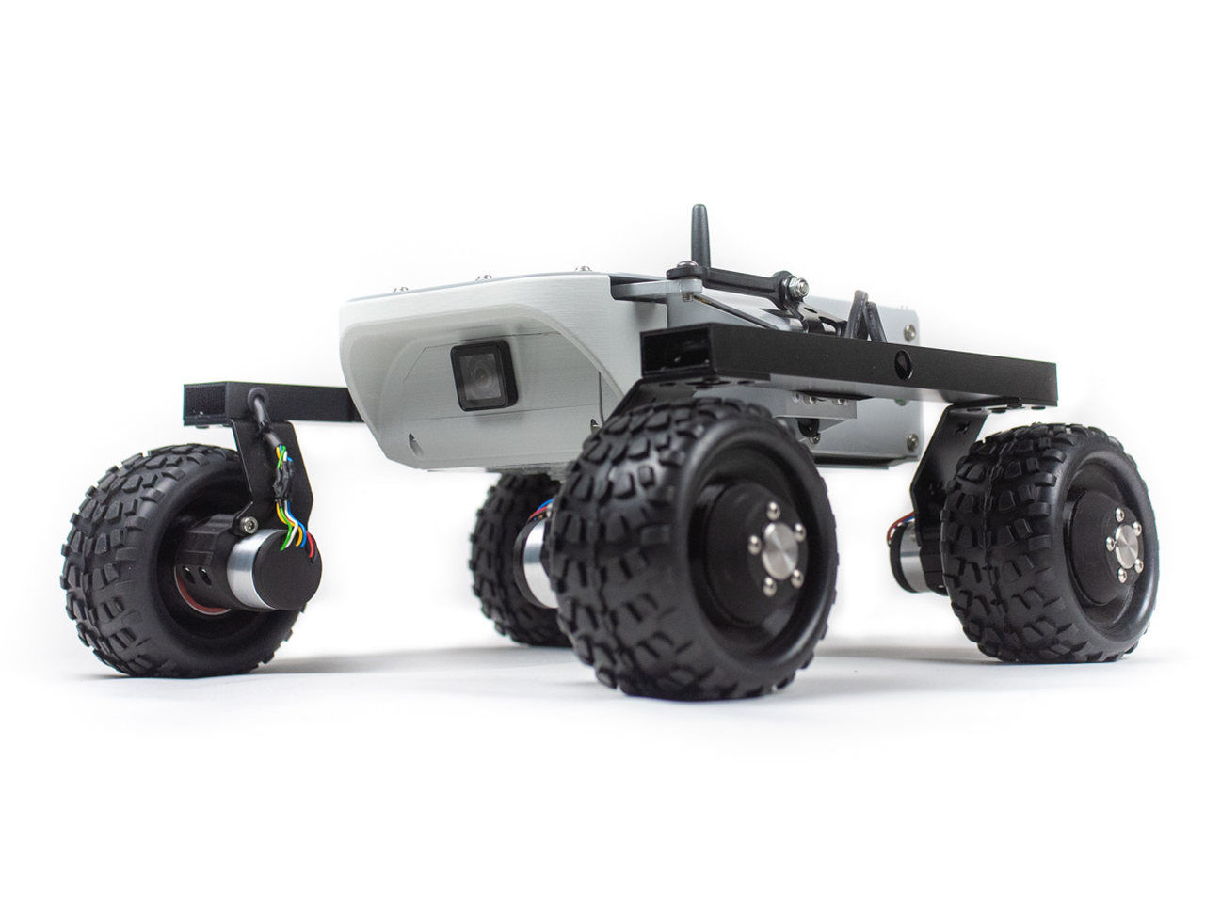
Categories of Robots
Types of Robots:
Wheeled Robots: Mobility on wheels for efficient navigation.
Humanoid Robots: Designed to resemble human form and function.
Swarm Robots: Coordinated groups working together to complete tasks.
Aerial Drones: Unmanned aerial vehicles for surveillance and delivery.
Understanding these categories helps in recognizing the diverse capabilities of robots.

Slide 19
Thank You
Thank you for your attention! I hope this overview of the AI course has sparked your interest and enthusiasm for the fascinating world of Artificial Intelligence. Please feel free to ask any questions or share your thoughts!

